Slide 1

Pune Vidyarthi Griha's College of Engineering and Technology
Department of E&TC AY: 2020-21
IIT B DSP MOOC INTERNSHIP
Guided By: Vikram Gadre Sir

Slide 2
Speech Denoising using Deep Learning
Submitted By
Mohammad Shahbaz Alam
Devidas Ingale
Avdhoot Patil

Slide 3
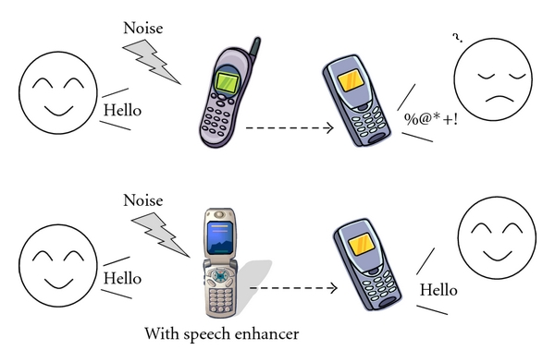
Speech Denoising
Speech signal denoising (or enhancement), is the removal of noise and distortions present in the signal for recovering back the original signal, free from noise. The objective is to improve the Signal-to-Noise Ratio (SNR) of the incoming speech audio.
This is an important application of Digital Signal Processing, which has various uses such as in cellular phones, hearing aids, teleconferencing etc.

Slide 4
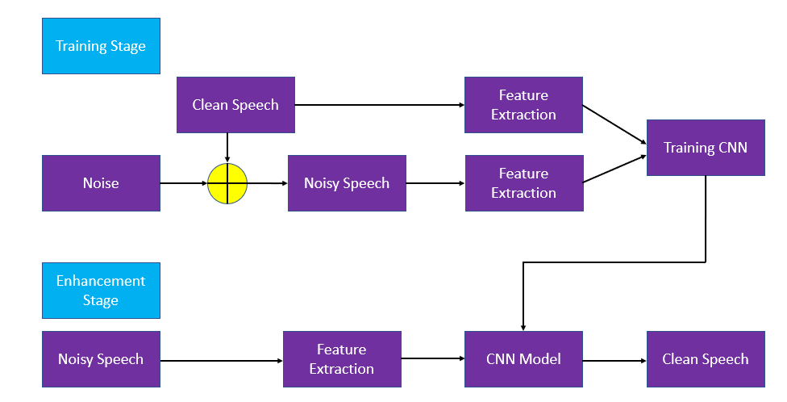
Block Diagram

Slide 5
Major steps in our project
Pre-processing using short term Fourier transform
Use of Convolutional neural network model
Our project takes input noisy signal and two noisy & clean signals for training then gives back denoised audio signals.

Slide 6
Pre-processing
In pre-processing the raw input signal is taken and converts it into a form, which can be effectively used by the processing system.
In our project we transformed the raw input signal using Short-Time Fourier Transform

Slide 7
Pre-processing
In Preprocessing is an essential step for removal of noise and distortion present in the signal, due to corruption caused by various sources such as channel medium, receiving antenna etc.
In case of deep learning, it has the tasks of:
Data cleansing
Data editing
Data reduction
Data wrangling

Slide 8
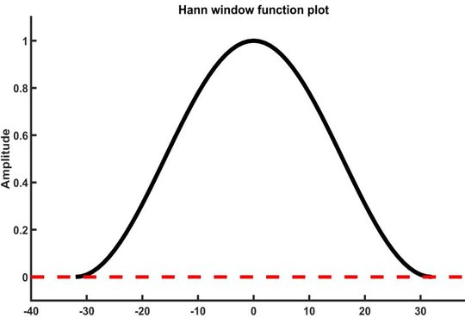
Short-Time Fourier transform
The STFT represents a signal in the time-frequency domain by computing discrete Fourier transforms (DFT) over short overlapping windows.
The window function used also plays a crucial role, in our application we have used Hann window.
CREDITS: Electronics Related

Slide 9
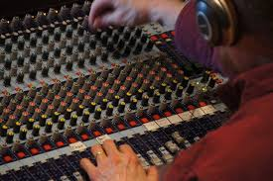
Short-Time Fourier transform
Applications
Analysis of speech signal for efficient denoising
Used in audio engineering [mixing, equalization, etc.]
Analysing and filtering music compositions
Capable of being utilized in every possible audio processing application
CREDITS: Audio Science

Slide 10
Short-Time Fourier transform
Advantages:
As a time-dependent transform, widely used in the analysis of non-stationary signals such as speech signals.
Provides information of signal in both frequency and time domain
Shortcomings
Trade-off involved between the time and frequency resolutions, making it less efficient for analysis of non-periodic signals with fast transient features

Slide 11
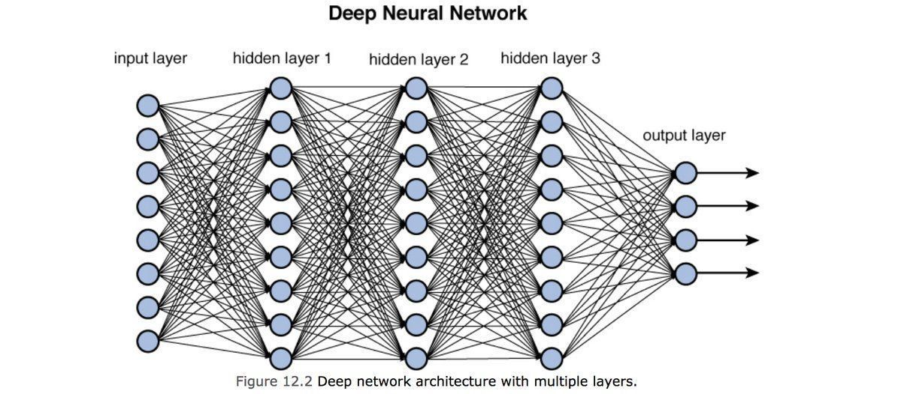
Deep Learning
We now introduce deep learning into the picture. Neural networks have been widely used in the past to tackle a variety of problems in the fields of audio processing, image processing & video processing.
They provide us a way to possible learn a nonlinear mapping relationship between the inputs and the outputs.
CREDITS: Towards Data science

Slide 12
Algorithm Used
Loading training and testing input audio files using load() function of librosa by which audio files are converted into NumPy array.
Computing short time fourier transform on all those input audio files array, using stft() function of librosa which transforms this array (consisting amplitude in time domain) to frequency domain. This helps in removing high frequency noise.
Calculate magnitude of all input files using NumPy.
Defining CNN model specifications like learning rate, epochs, no. of layers, filters, kernels. After every convolutional layer we are adding pooling layer. Non linearity ReLu has been applied to feature maps output by convolutional layer.
We defined mean square loss function with Adam optimizer to minimize the loss between expected and model output to train deep learning model
We use neural networks to find a transformation between the already pre-processed noisy clip and the clean clip.
Then we performed maxpooling and added a fully connected layer at the end to reduce the dimensionality and get the desired dimensions.
After training the model, we tested the performance of the model by calculating the Signal-to-Noise Ratio (SNR) value and performed ISTFT to check how the audio sounded.

Slide 13
Speech Denoising using 1D CNN
In 1D CNN, kernel moves in 1 direction. Input and output data of 1D CNN is 2 dimensional. Mostly used on Time-Series data.
In this problem, we have implemented a 1D CNN that does speech denoising in the STFT magnitude domain. 1D CNN here means a variant of CNN which does the convolution operation along only one of the axis. In this case it's the frequency axis.
After training the model, we tested the performance of the model by calculating the Signal-to-Noise Ratio (SNR) value and performed ISTFT to check how the audio sounded.

Slide 14
1D CNN Design implemented:
- Two convolution layers with filters 16 and 32 respectively.
- Also kernel sizes of 16, 8 respectively.
- Same padding is used.
- ReLU activation function is used in all the convolution layers.
- Max pooling layers are implemented one each after the convolution layer.
- Flattening is implemented for the last max pooling layer.
- A dense layer of 513 units with a ReLU activation.
- Adam optimizer, mean squared error loss function are used.
- 1000 epochs are used for training.

Slide 15
Speech Denoising 2D CNN
In 2D CNN, kernel moves in 2 directions. Input and output data of 2D CNN is 3 dimensional. Mostly used on Image data.
In this problem, since we are using a 2D CNN, we will consider both time and frequency of the audio.
Once the model is built, we can test its performance on the test audio by calculating SNR and listening to check if the noise is removed or not.

Slide 16
2D CNN Design implemented
- Input layer with Tensor Shape as (-1,20,513,1).
- Two convolution layers used with filters of 16,32 are used respectively.
- Also kernel size of (4,4) for all of the above layers.
- ReLU activation is used in all the convolution layers.
- Max pooling layers are used after each convolution layer, with pool size of (2,2).
- Final max pooling layer is flattened.
- A dense layer is used with 513 hidden units with ReLU activation function.
- Adam optimizer (0.0002 learning rate) and Mean squared error Loss function are used.
- Batch size of 64 and 500 epochs for training.

Slide 17
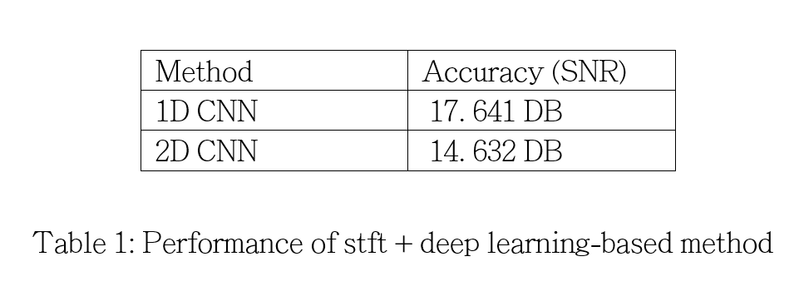
Observations
Here, we compare the performances of speech denoising first computing stft then applying deep learning model by 1D CNN & 2D CNN.

Slide 18
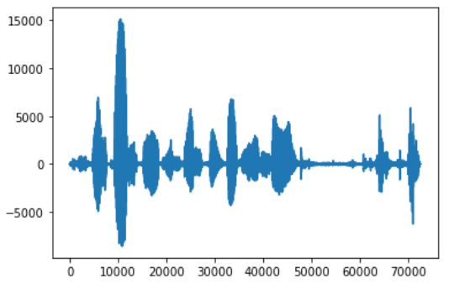
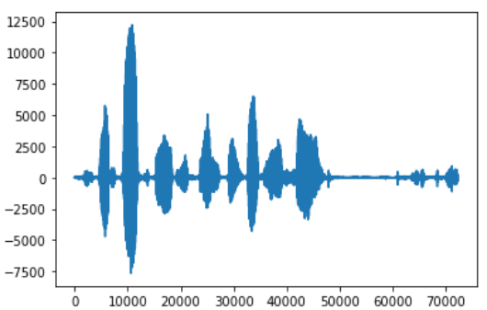
Waveforms
Noisy Audio
Denoised Audio by 1D CNN

Slide 19
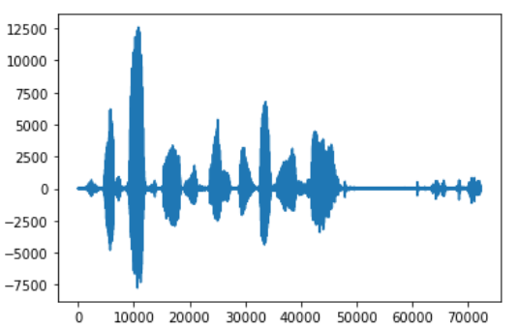
Waveforms
Noisy Audio
Denoised Audio by 2D CNN

Slide 20
Conclusion
Hence it is evident from the results that using (1D CNN + stft) gives better result compared to (2D CNN + stft) for speech denoising by removal of noise from noisy speech and speech enhancement.
By having SNR of 17.64 DB by 1D CNN compared to 14.632 DB by 2D CNN.

Slide 21
Reference
P. C. Loizou, Speech Enhancement: Theory and Practice, 2nd ed. CRC Press, 2013.
M. Bosi and R. E. Goldberg, Introduction to Digital Audio Coding and Standards. Springer, 2002.
F. G. Germain, Q. Chen, and V. Koltun. Speech Denoising with Deep Feature Losses. 2018.
A. Kumar and D. Florencio: Speech Enhancement in Multiple Noise Conditions using Deep Neural Networks. 2016.
Shi, Y., Rong, W., & Zheng, N. (2018). Speech Enhancement using Convolutional Neural Network with Skip Connections. 2018 11th International Symposium on Chinese Spoken Language Processing (ISCSLP). "DOI":10.1109/iscslp.2018.8706591
Ouyang, Z., Yu, H., Zhu, W.-P., & Champagne, B. (2019). A Fully Convolutional Neural Network for Complex Spectrogram Processing in Speech Enhancement. ICASSP 2019 - 2019 IEEE International Conference on Acoustics, Speech and Signal Processing (ICASSP). doi:10.1109/icassp.2019.8683423
L1 loss for speech denoising: https://arxiv.org/abs/1806.10522
Adaptive Batch Normalization: https://arxiv.org/abs/1603.04779
Short Time Fourier Transform: https://www.sciencedirect.com/topics/engineering/short-time-fourier-transform
https://ieeexplore.ieee.org/document/9057895
https://www.deeplearningbook.org/contents/convnets.html
https://www.dataversity.net/brief-history-deep-learning/#
https://www.ijarcce.com/upload/2016/si/SITES-16/IJARCCE-SITES%206.pdf
https://github.com/shaharpit809/Speech-Denoising-using-DNN-CNN-and-RNN/blob/master/CNN/1D-CNN.ipynb
https://drive.google.com/drive/folders/1plJFLtRjicWFF-wzKs2PFmmXunpkxsC3?usp=sharing
https://sthalles.github.io/practical-deep-learning-audio-denoising/
https://towardsdatascience.com/speech-enhancement-with-deep-learning-36a1991d3d8d

Slide 22
Thank You

